Slide 1
ngrok
Lecturer: Ngo Huy Bien
Software Engineering Department
Faculty of Information Technology
University of Science
Ho Chi Minh City, Vietnam
nhbien@fit.hcmus.edu.vn

Slide 2

Objectives

Slide 3

Contents

Slide 4

References

Slide 5
ngrok
https://ngrok.com/
All-in-one API gateway, Kubernetes Ingress, DDoS protection, firewall, and global load balancing as a service.

Slide 6
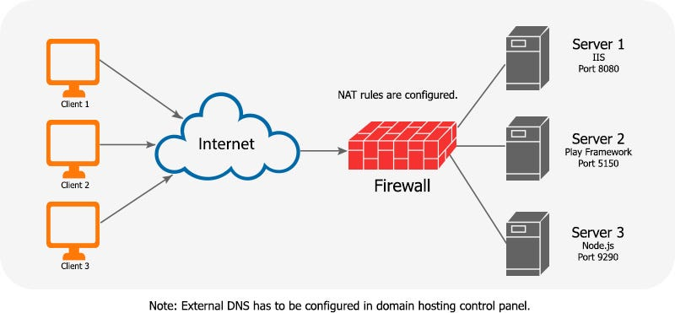
Architecture WITHOUT ngrok
https://surajpanker82.medium.com/ngrok-96fd33ca869c

Slide 7
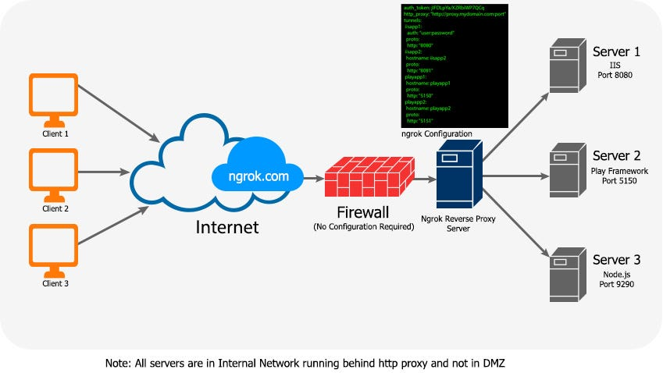
Architecture WITH ngrok

Slide 8


Slide 9
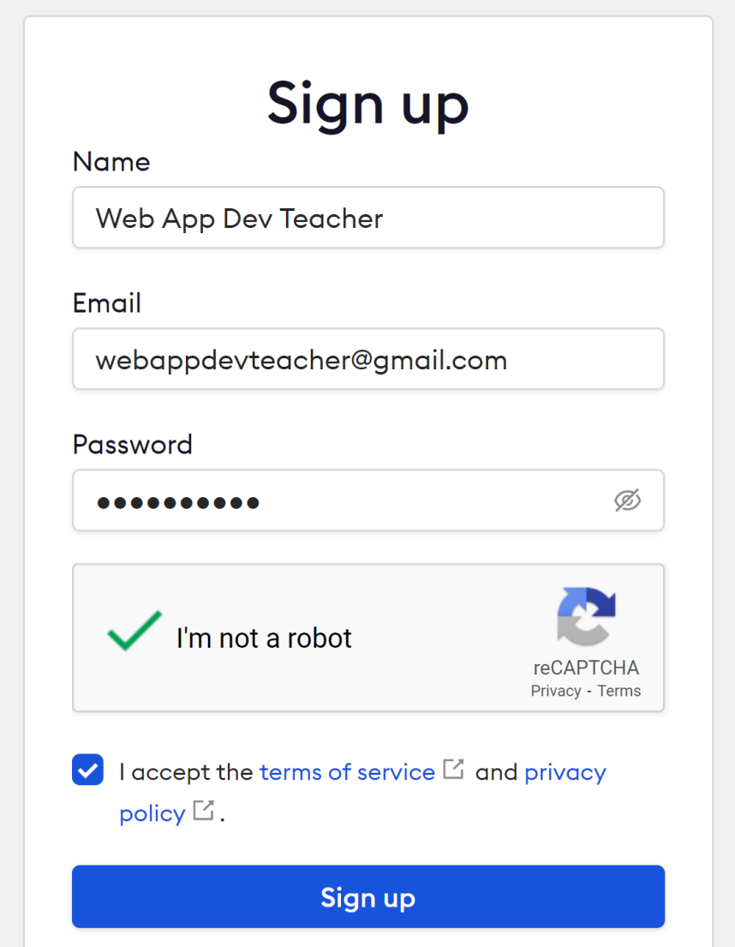
1. Register an Account
https://dashboard.ngrok.com/signup

Slide 10
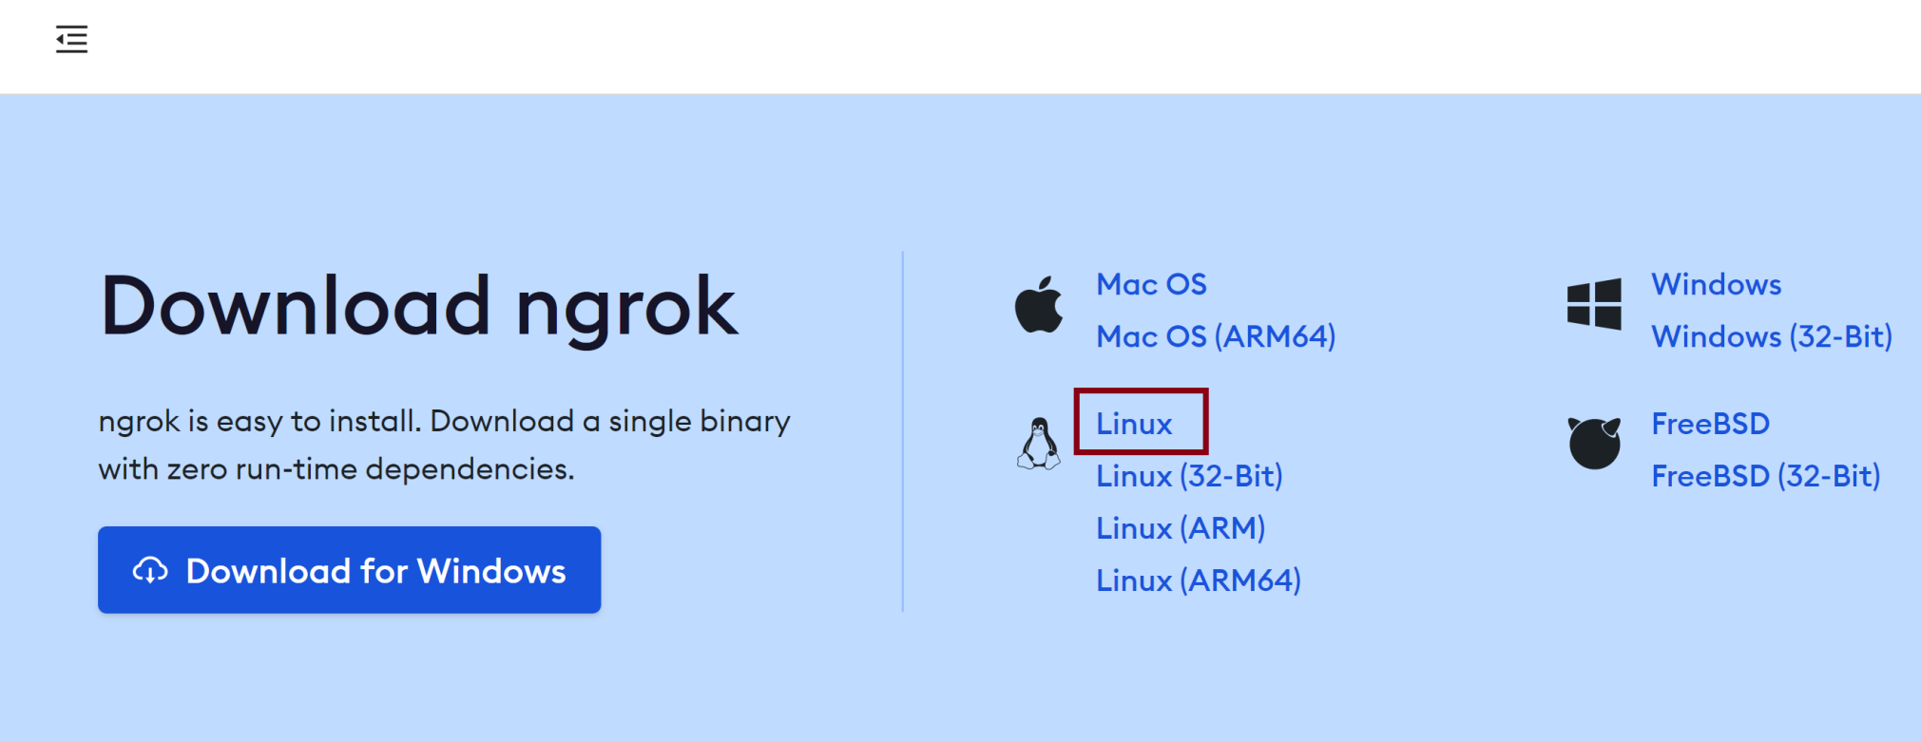
2. Copy ngrok Download URL
https://bin.equinox.io/c/bNyj1mQVY4c/ngrok-v3-stable-linux-amd64.tgz

Slide 11
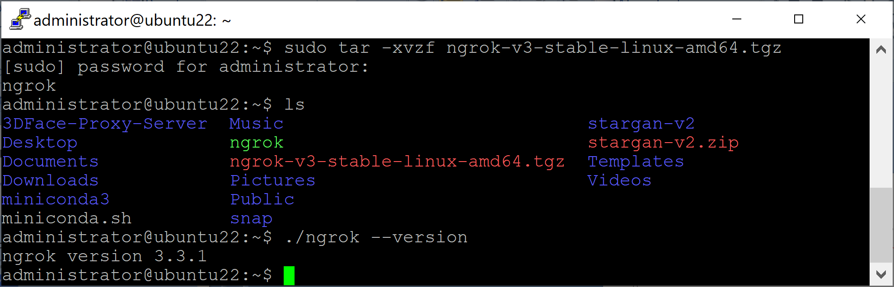
3. Download ngrok on Ubuntu
wget https://bin.equinox.io/c/bNyj1mQVY4c/ngrok-v3-stable-linux-amd64.tgz
ls
sudo tar -xvzf ngrok-v3-stable-linux-amd64.tgz
ls
./ngrok --version

Slide 12
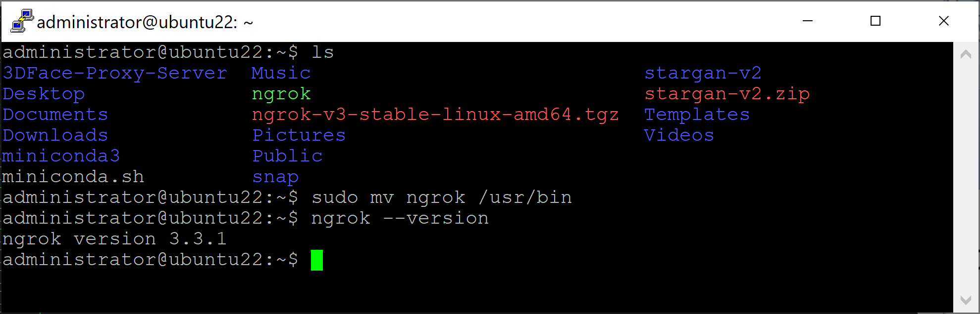
4. Move ngrok to /usr/bin
# /usr/bin contains executable files that are not part of the core operating system.
sudo mv ngrok /usr/bin
ngrok --version

Slide 13
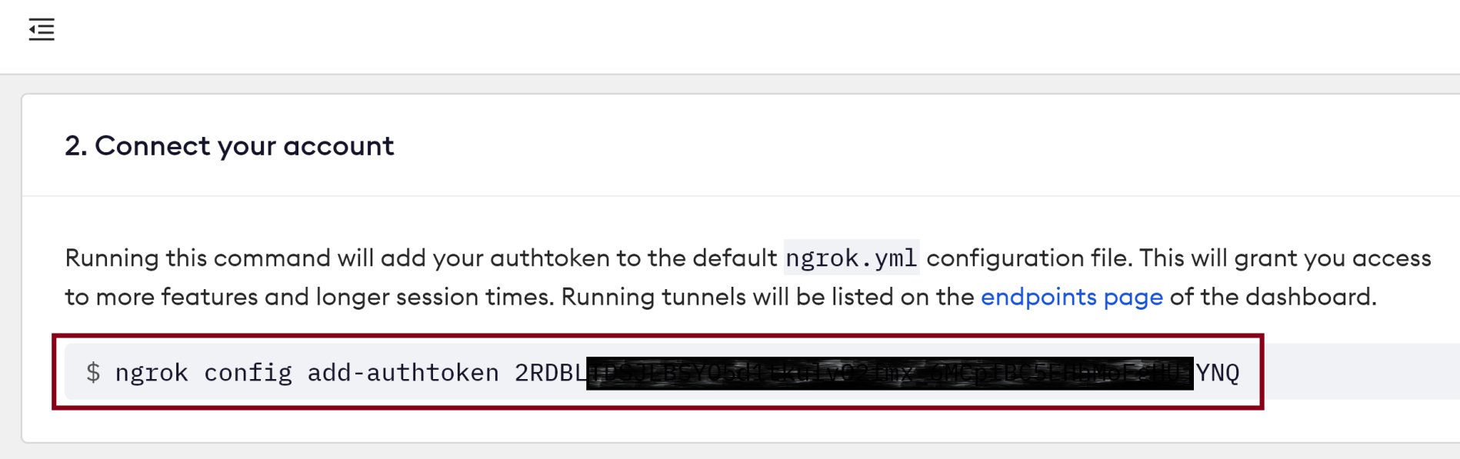
5. Copy Connect Command
ngrok config add-authtoken 2RDBLTDSJLBSYO5d1tkulv02fmx_6MCpfBC5EHhMoFgHUjYNQ

Slide 14
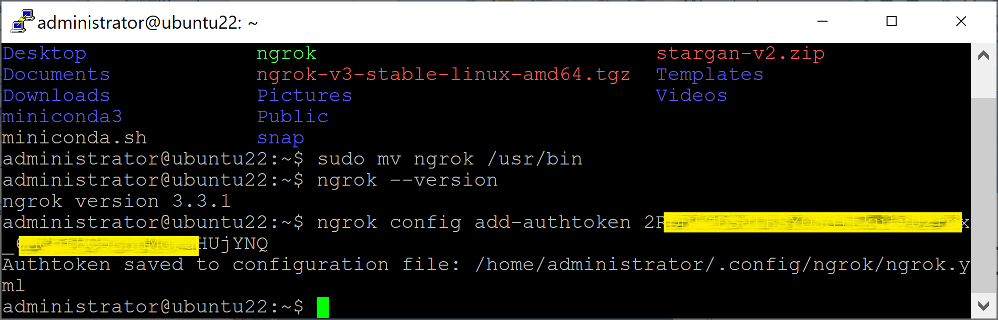
6. Execute the Connect Command
ngrok config add-authtoken 2RDBLTDSJLBSYO5d1tkulv02fmx_6MCpfBC5EHhMoFgHUjYNQ

Slide 15
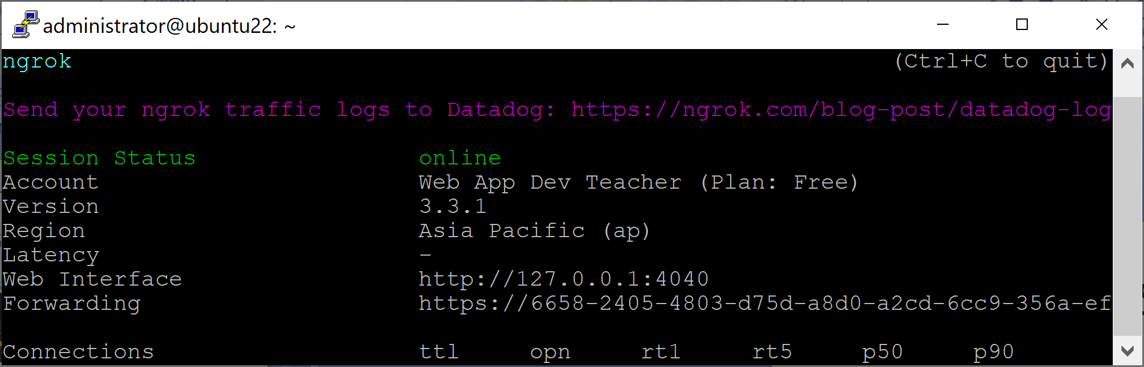
7. Publish Your Service
# If your service has been served on http://localhost:8080
ngrok http 8080

Slide 16
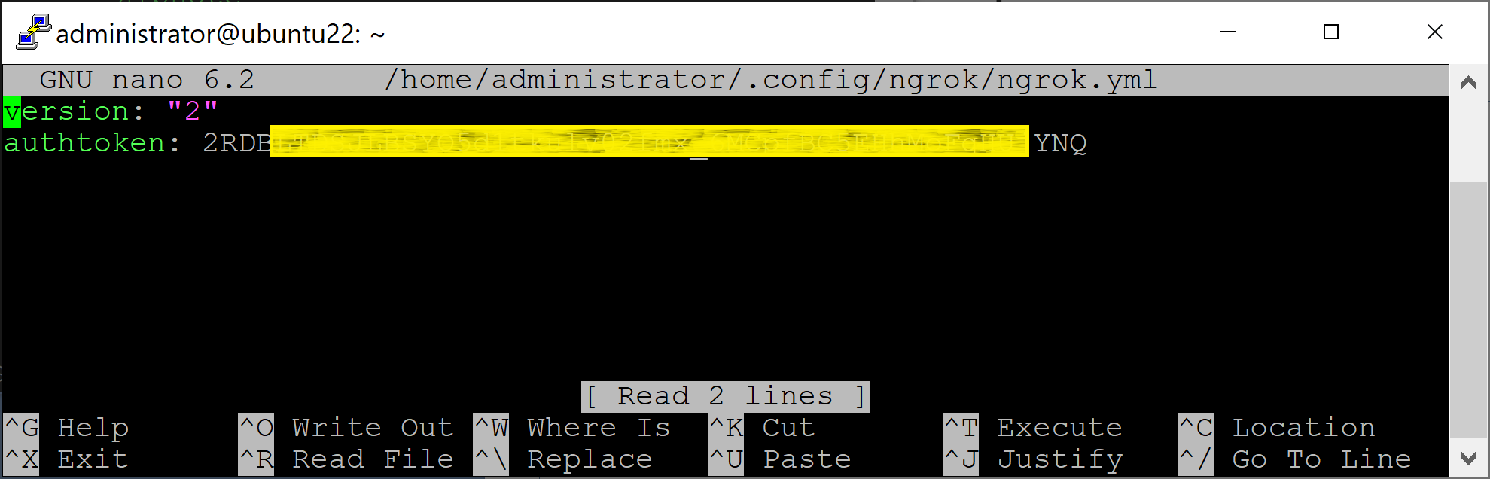
8. Edit Configuration
ngrok config edit

Slide 18
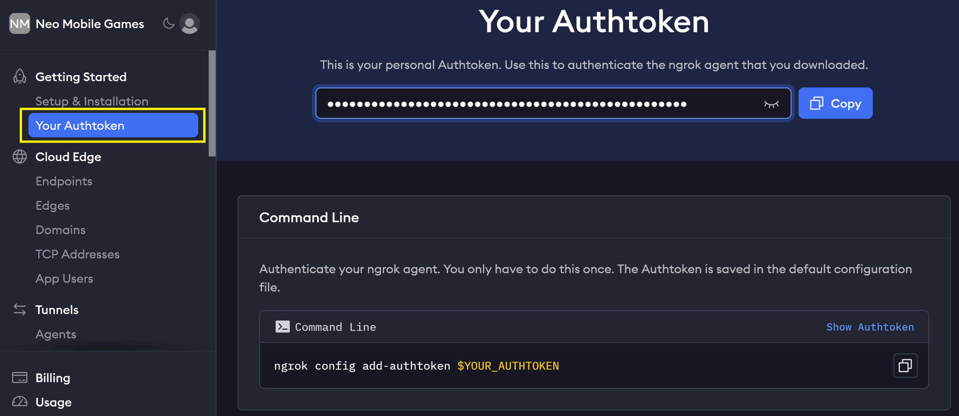
1. Retrieve Auth Token

Slide 20
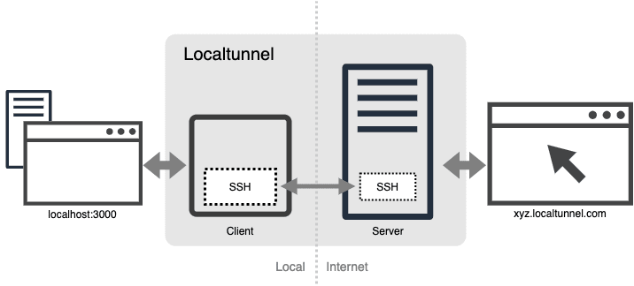
Inside ngrok
https://dev.to/progrium/building-your-own-ngrok-in-130-lines-2lif

Slide 21

Thank You & See You Again

